Slide 1
Software Engineering Individual Project
Tiles
- Saurabh Pathak

Slide 2
Description
The game will present a 2X2 matrix of tiles.
Each tile will have a unique number or a pattern hidden behind it.
Each unique number/pattern exists twice in the matrix.
Once the player taps a tile, it flips and shows the pattern behind it.
The player has to match (by tapping consecutively) two tiles with same number/pattern hidden behind them.
If you match two tiles with different pattern, both the tiles will rotate and hide the pattern behind them.

Slide 3
core elements
2D matrix of tiles
Timer as per level

Slide 4
Additional elements
3D view of tiles
Multiplayer feature

Slide 5

Appearance and interaction

Slide 6
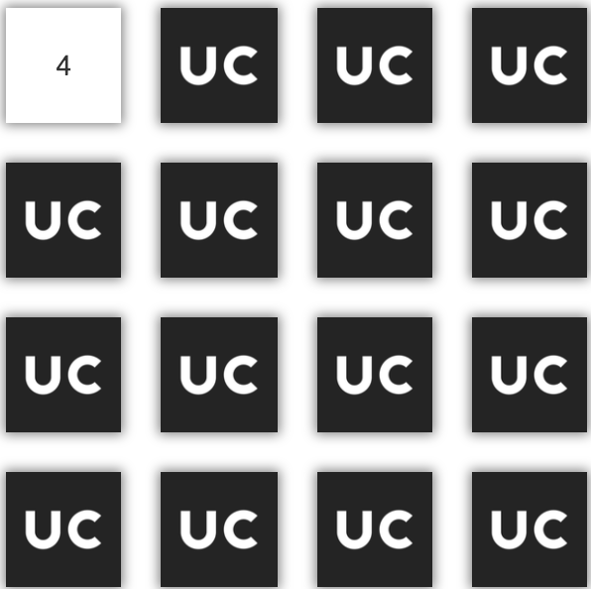
Appearance and interaction

Slide 7
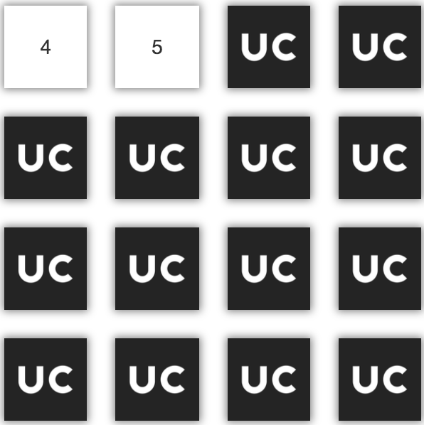
Appearance and interaction

Slide 8
Appearance and interaction

Slide 9
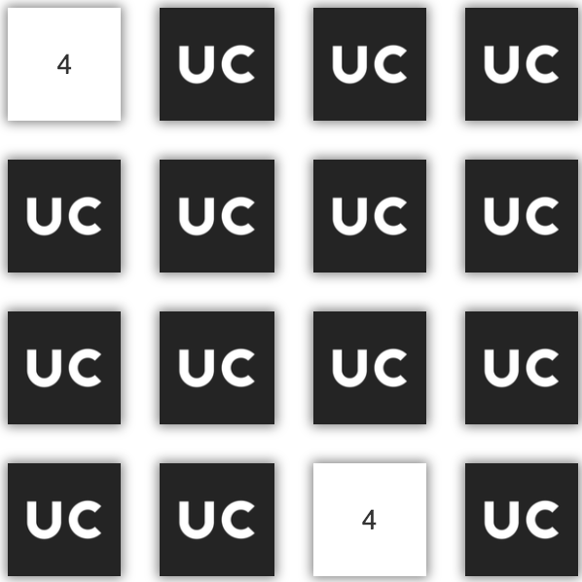
Appearance and interaction

Slide 10
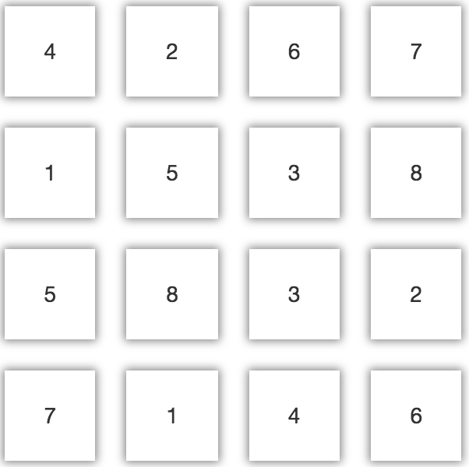
Appearance and interaction

